Slide 1
Object Detection
Thang Nguyen

Slide 2



What is Object Detection
Cat

Slide 3

What is Object Detection
Answer:
Step 1: Find Regional Proposals
Step 2: Regional Object Recognition
Step3: Bounding Box Regression

Slide 4
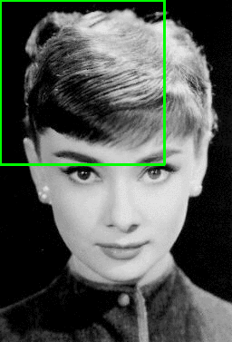
How to find Regional Proposals
Sliding Windows
Drawback ???
~ 10,000 Region/Image
=> Too expensive in computation

Slide 5
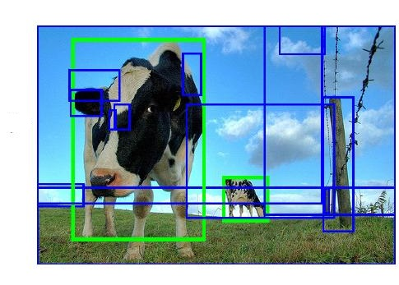
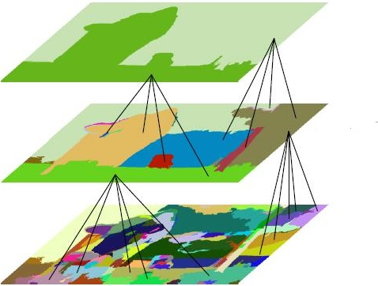
How to find Regional Proposals
Selective Search:
Implemented In R-CNN
~ 2000 Region/ Image

Slide 6
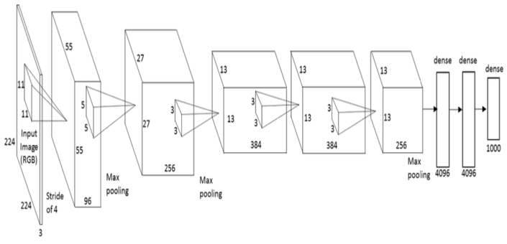
Regional Object Recognition Model
AlexNet Architecture

Slide 7
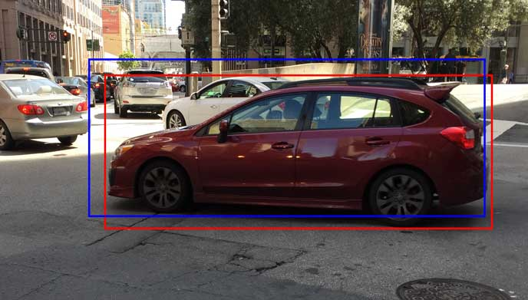
Bounding Box Regression
Blue Box - Initial Box(region)
Red Box – Ground Truth Box

Slide 8
Challenge Dataset
ILSVRC (ImageNet Large Scale Visual Recognition Challenge) organized by Researchers from University of Stanford, Princeton, North Carolina
Pascal VOC (Visual Object Classes) organized by Researchers from University Of Oxford, Cambridge, Zurich

Slide 9
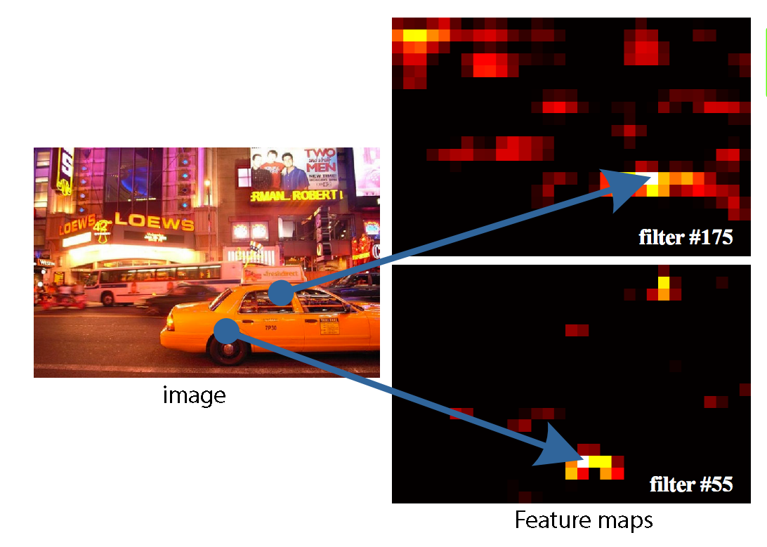
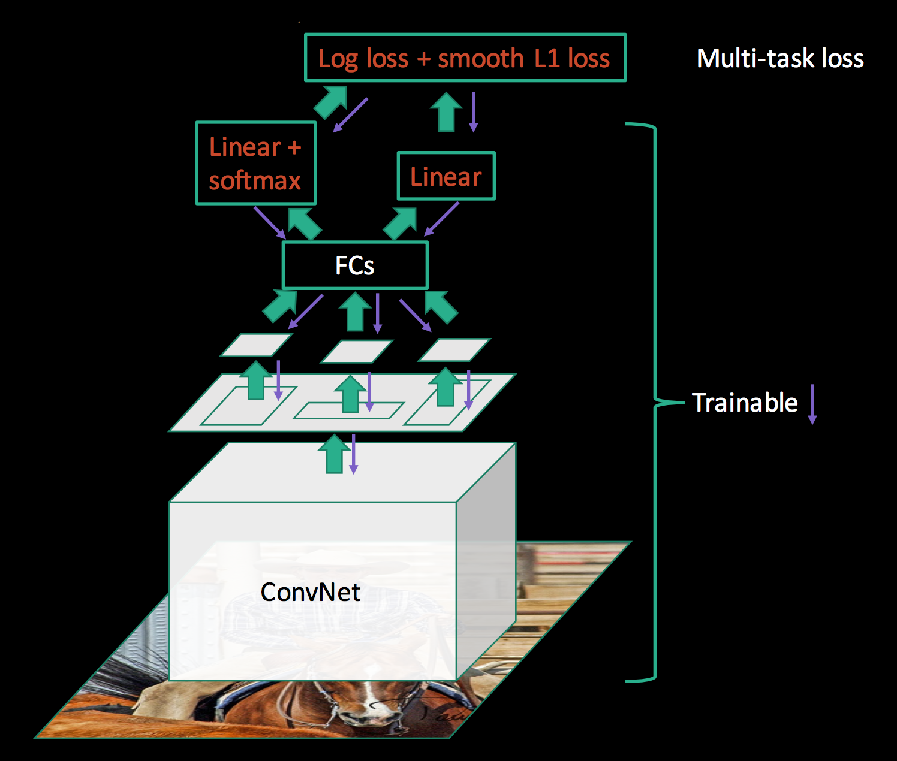
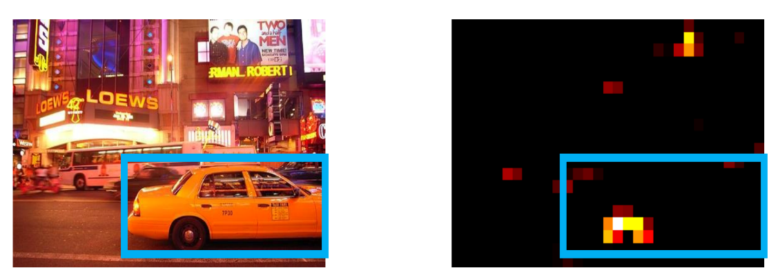
State Of Art Models
Fast RCNN

Slide 10
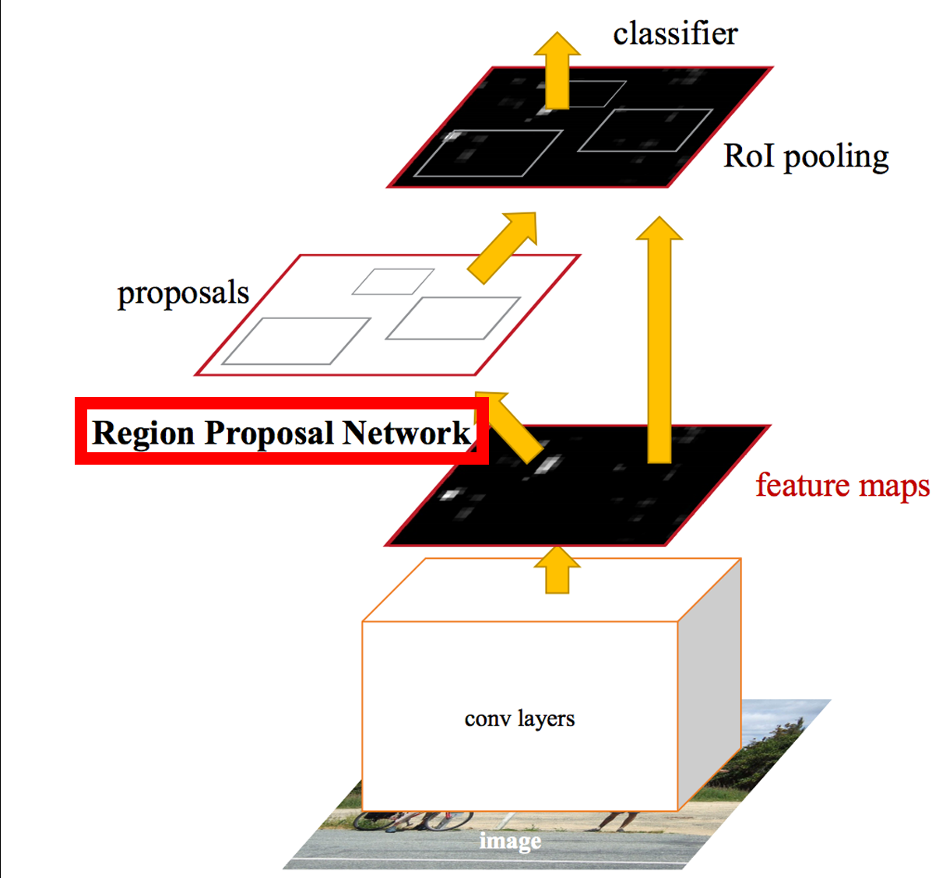
State Of Art Models
Faster R-CNN
Do Not need a Special Regional Proposal Method
Train a separate neural network that predicts the region proposal

Slide 11
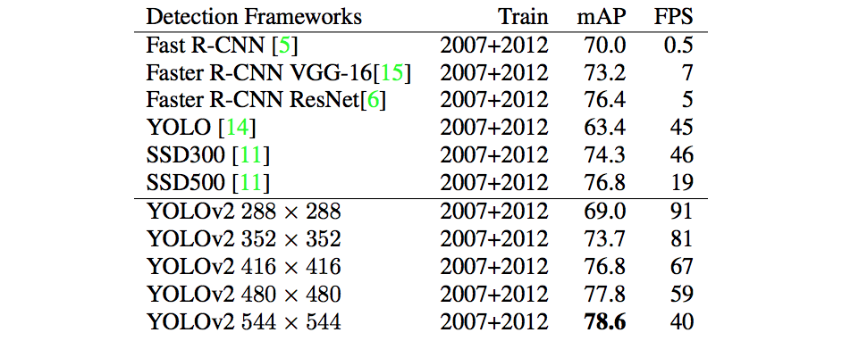
State Of Art Models

